Slide 1



Notes:
R&S 200: The Kingdom of God is Justice & Joy
R&S 620 For the Healing of the Nations
R&S 625 God of Freedom, God of Justice (communion hymn)
The Church is wherever God's people (words changed) tune: Bard of Armagh

Slide 2



What is…

Slide 3

The URC’s global justice programme…
is…

Slide 4

Enabling local congregations to engage in their mission for global justice
Together with our partners Christian Aid & Global Justice Now…
Through prayer, advocacy, action, learning & sharing

Slide 5

Notes:
Honduras, El Salvador, Nicaragua, Guatemala

Slide 6

y
Notes:
Honduras, El Salvador, Nicaragua, Guatemala

Slide 7
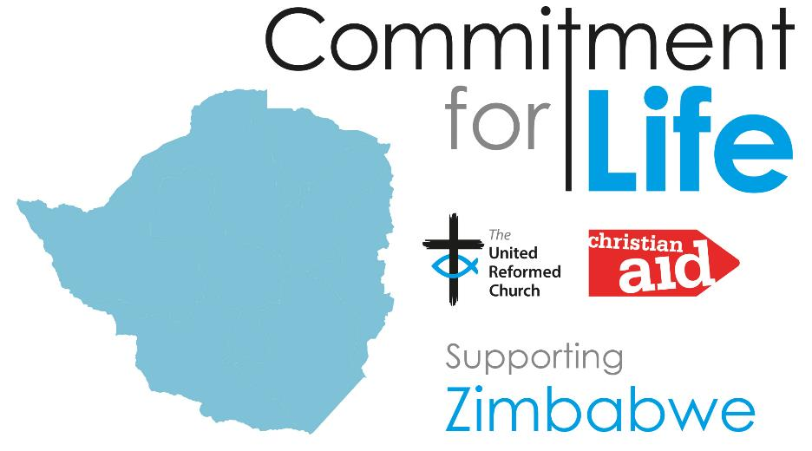
Notes:
Honduras, El Salvador, Nicaragua, Guatemala

Slide 8
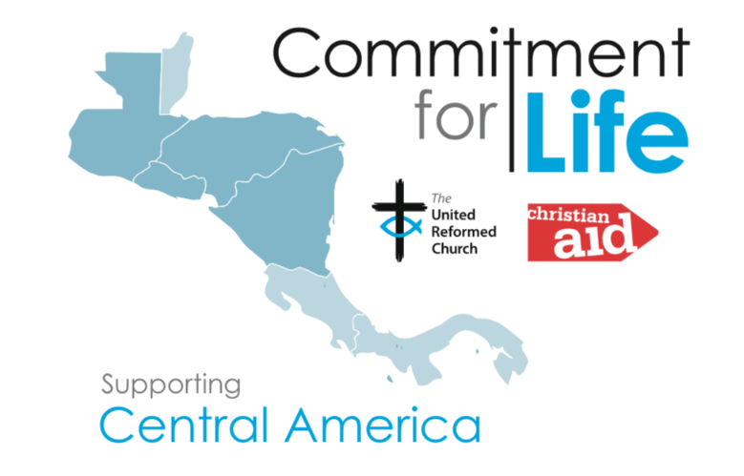
Guess the countries - H.E.N.G.
Notes:
Honduras, El Salvador, Nicaragua, Guatemala

Slide 9
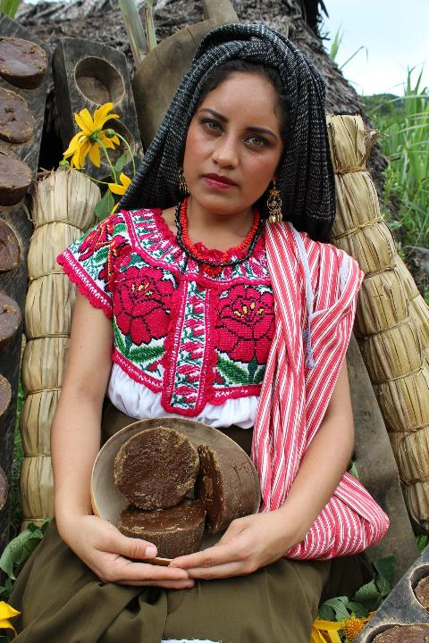

Train traditional Doulas
Train Health Care staff to welcome indigenous people
Family planning - contraception, HIV
Gender-based violence
Notes:
Our Commitment for Life partners are:
- training traditional birth attendants to provide healthcare, including family planning
- working with health facilities so women from indigenous communities are welcomed, not excluded
- ensuring that contraceptive supplies are readily available
- educating teachers, heads of families and pupils on family planning, HIV, pregnancy and sexual and gender based violence, pushing for change at a national level by building up civil society and recording findings from these projects

Slide 10

Pray Learn Advocate Share

Slide 11



Slide 12

Website: Google “Commitment for Life URC”
Facebook: @comm4life
suzanne.pearson@urc.org.uk
For monthly e-newsletter & resources

