Slide 1
Closed
Churches 2018
Notes:
7.40 minutes running time

Slide 2
Closed Churches Resolution 20 General Assembly notes the closures listed, with praise to God for the worship and witness offered by these fellowships across the years.
Page 77

Slide 3
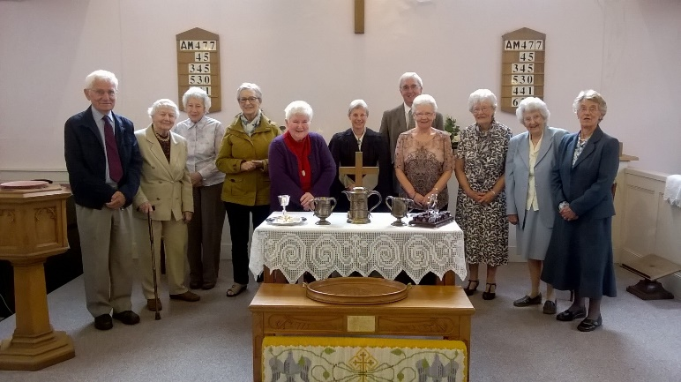
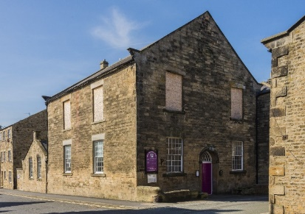
^{Synod 1: Northern}
Barnard Castle United Reformed Church ^{Barnard Castle} ^{2 October 2016}

Slide 4
^{Synod 1: Northern}
^{Oxclose LEP} ^{Washington} ^{1 September 2017} continues as an Anglican Church

Slide 5
^{Synod 2: North Western}
^{Mossley Abney} ^{Aston-under-Lyne} ^{23 April 2017}

Slide 6
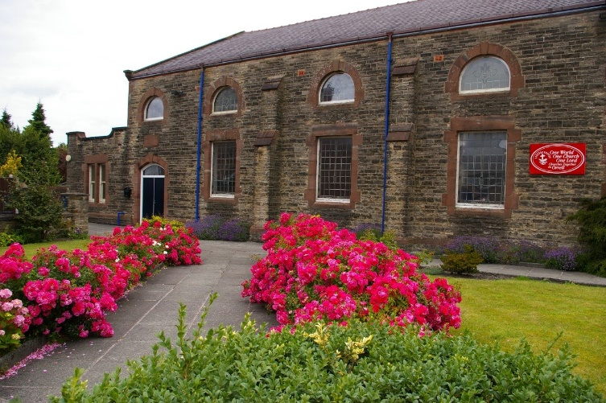
^{Synod 3: Mersey}
^{Salem United Reformed Church} ^{Orrell} ^{24 September 2017}

Slide 7
^{Synod 5: East Midlands}
^{Danesholme Community Church} ^{Corby} ^{15 January 2017}

Slide 8
^{Synod 6: West Midlands}
Brierley United Reformed Church ^{Brierley} ^{6 August 2017}

Slide 9
^{Synod 6: West Midlands} ^{Gorsty Hill United Church} ^{Stoke-on-Trent} ^{31 August 2016} continues as a Methodist church

Slide 10
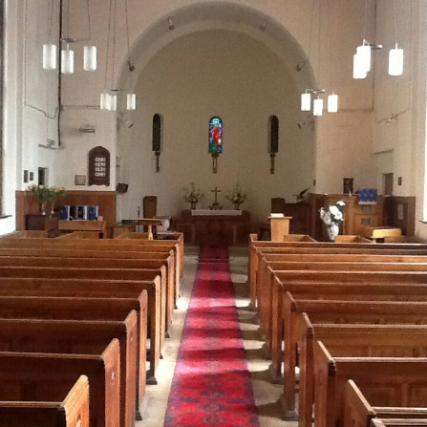
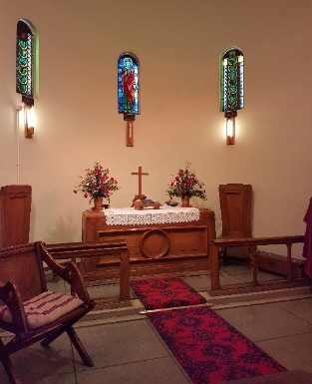
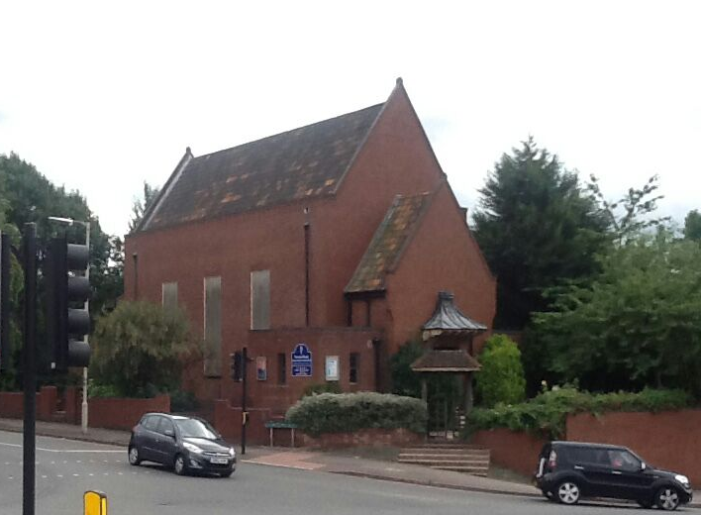
^{Synod 6: West Midlands} Newton Road United Reformed Church ^{Birmingham} ^{31 December 2017}

Slide 11
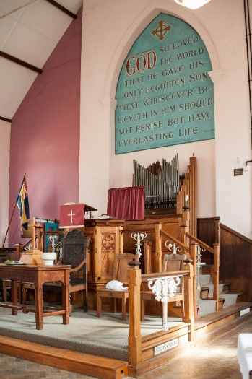
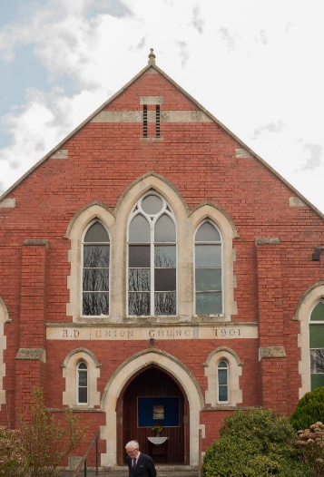
^{Synod 6: West Midlands} Sharpness United Reformed Church ^{Sharpness} ^{4 April 2016}

Slide 12
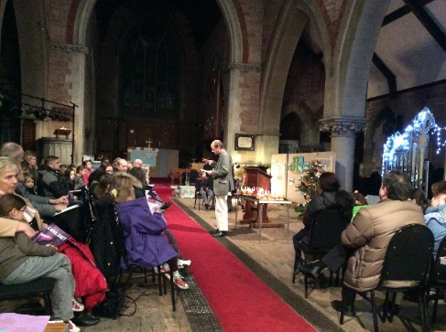
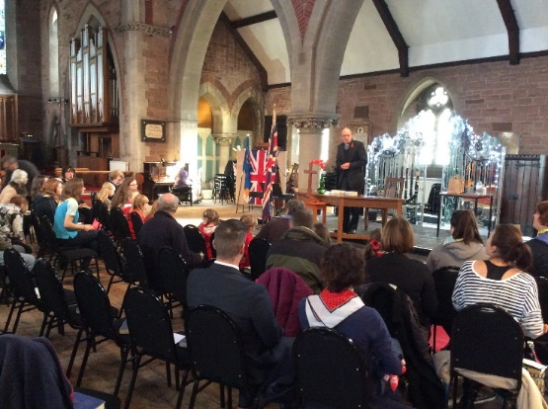
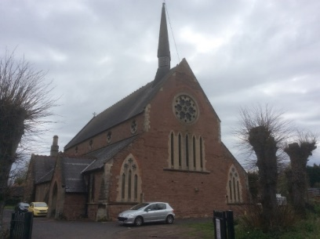
^{Synod 6: West Midlands} St John’s United Reformed Church ^{Stourbridge} ^{31 December 2016}

Slide 13
^{Synod 6: West Midlands}
^{St Michael’s & All Angels} ^{Stourport-on-Severn} ^{31 August 2016} continues as an Anglican Church

Slide 14
^{Synod 6: West Midlands}
^{Union Free Church} ^{Wellington} ^{31 March 2018}

Slide 15
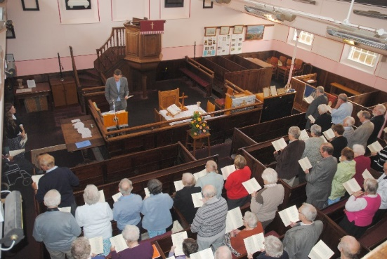
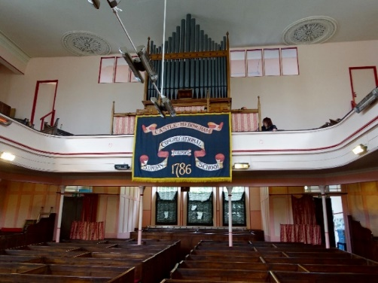
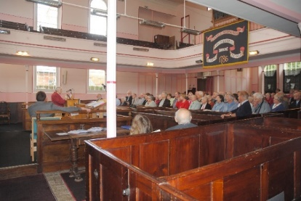
^{Synod 7: Eastern}
Castle Hedingham United Reformed Church ^{Castle Hedingham} ^{4 June 2016}

Slide 16
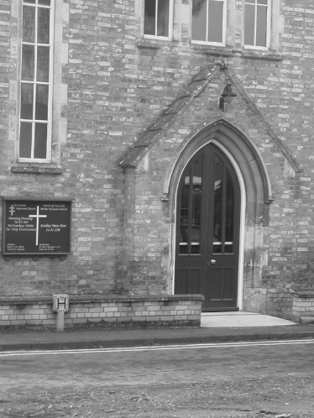
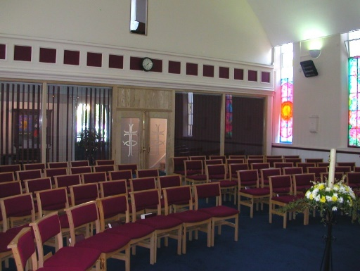
^{Synod 7: Eastern} Cavendish United Reformed Church ^{Cavendish} ^{15 October 2017}

Slide 17
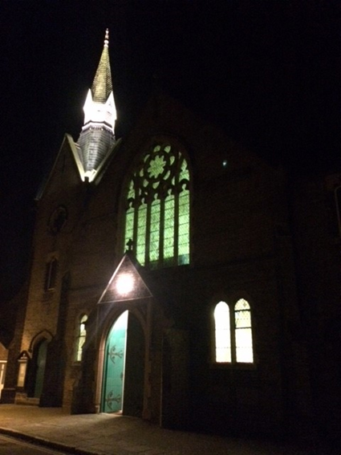
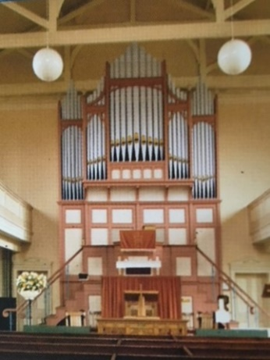
^{Synod 7: Eastern} Christ Church United Reformed Church ^{Sudbury} ^{7 January 2018}

Slide 18
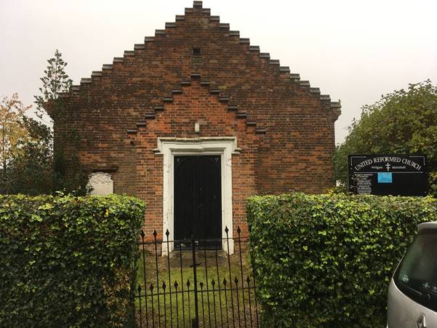
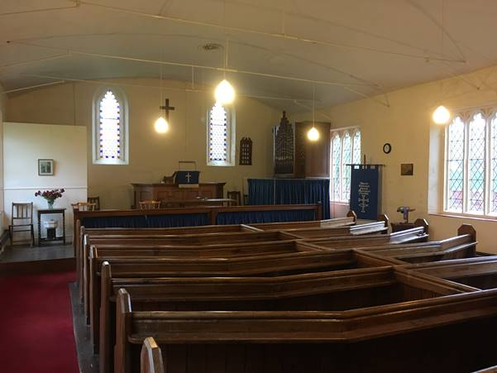
^{Synod 7: Eastern} Mattishall United Reformed Church ^{Mattishall} ^{31 December 2016}

Slide 19
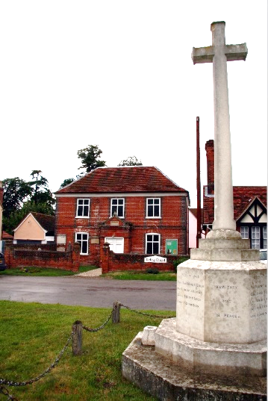
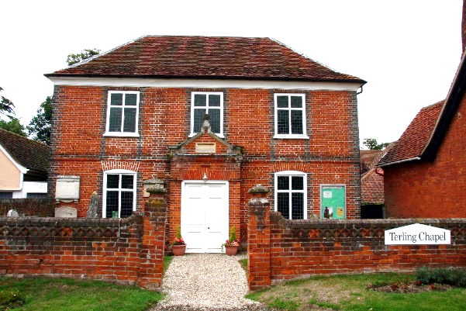
^{Synod 7: Eastern}
^{Terling United Reformed Church} ^{Terling} ^{31 March 2017}

Slide 20
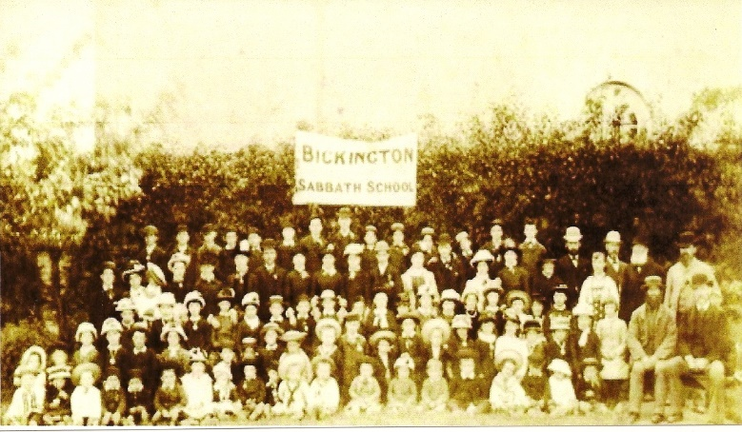
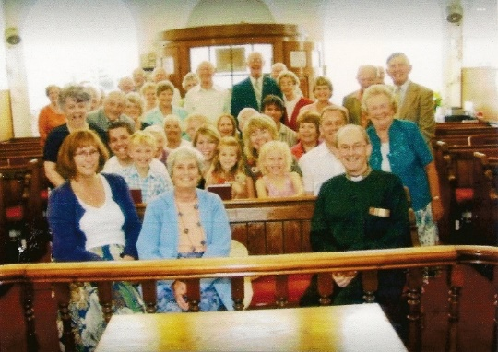
^{Synod 8: South Western} Bickington United Reformed Church ^{Bickington} ^{28 January 2018}

Slide 21
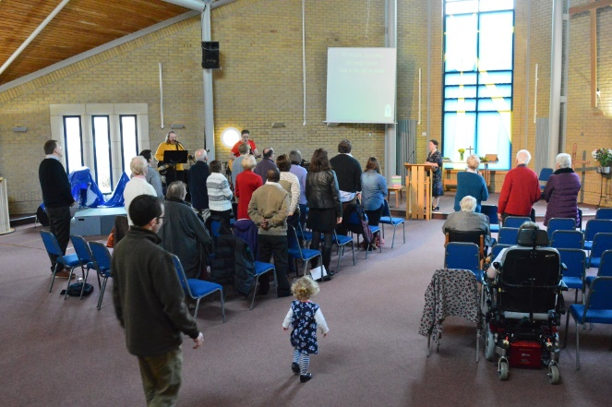
^{Synod 8: South Western}
^{Bradley Stoke, Holy Trinity} ^{Bristol} ^{10 September 2017} ^{continues with Methodist} ^{and Anglican involvement}

Slide 22
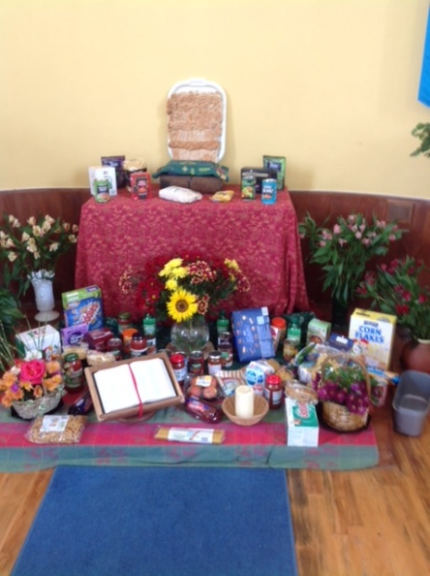
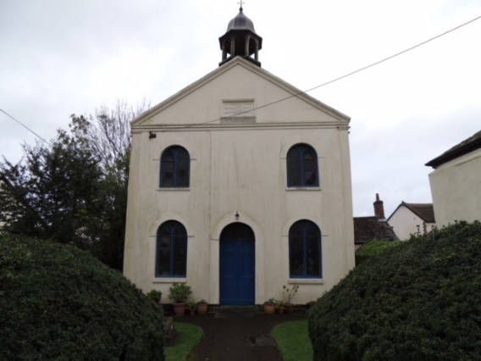
^{Synod 8: South Western} Christchurch United Reformed Church ^{Charmouth} ^{27 November 2016}

Slide 23
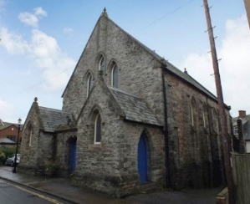
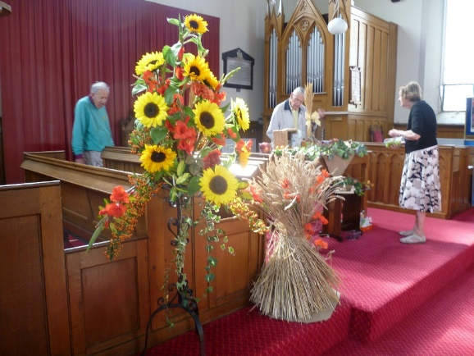
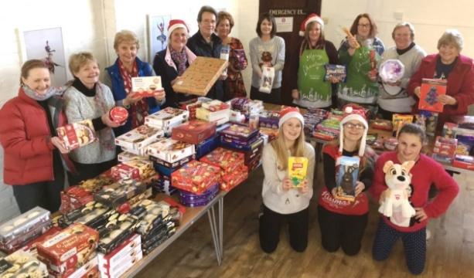
^{Synod 8: South Western} Sidmouth United Reformed Church ^{Sidmouth} ^{1 January 2017}

Slide 24
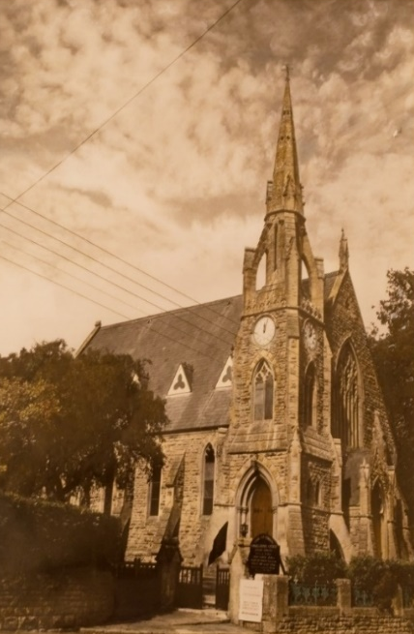
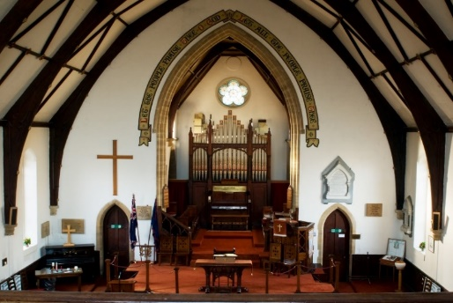
^{Synod 8: South Western} ^{Stoke sub Hamdon} ^{United Reformed Church} ^{Stoke sub Hamdon} ^{31 December 2016}

Slide 25
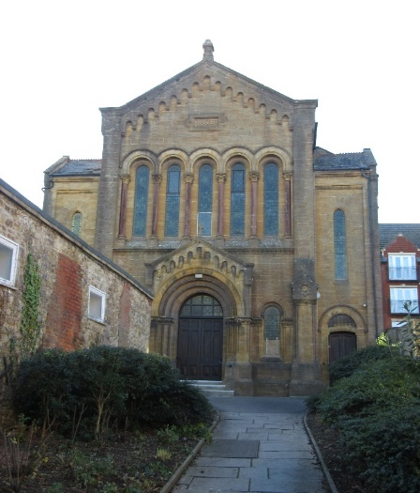
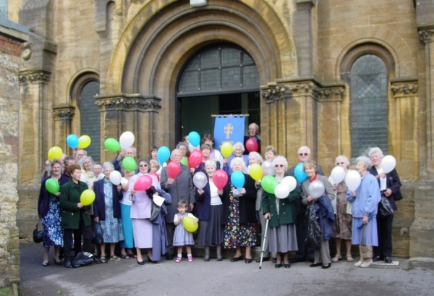
^{Synod 8: South Western}
^{Yeovil United Reformed Church} ^{Yeovil} ^{10 June 2017}

Slide 26
^{Synod 9: Wessex}
^{Christ Church} ^{Creekmoor} ^{2 October 2016} ^{continues as an} ^{Anglican church}

Slide 27
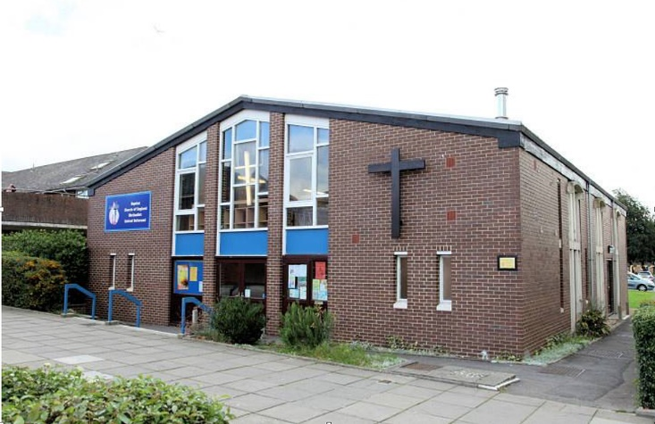
^{Synod 9: Wessex}
^{Lordshill Ecumenical Church} ^{Southampton} ^{16 July 2016} ^{continues as an} ^{ecumenical Church}

Slide 28
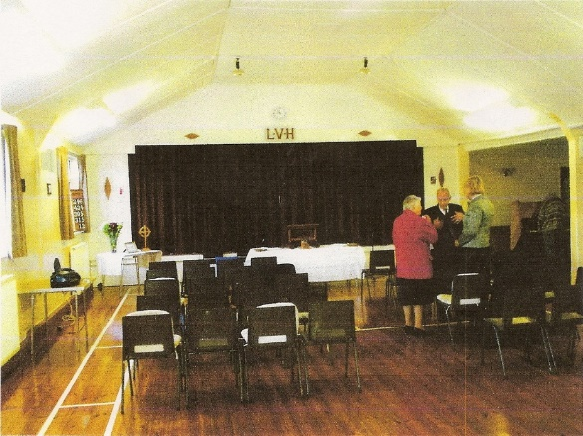
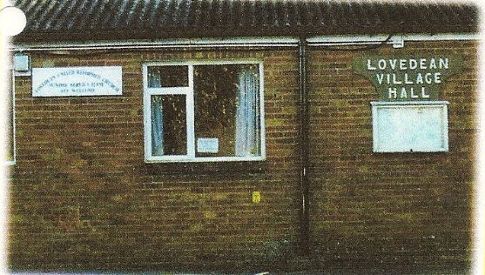
^{Synod 9: Wessex}
Lovedean United Reformed Church ^{Lovedean} ^{16 October 2016}

Slide 29
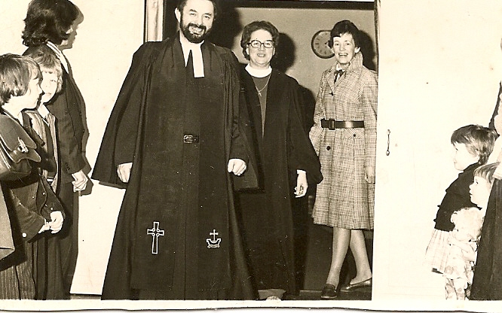
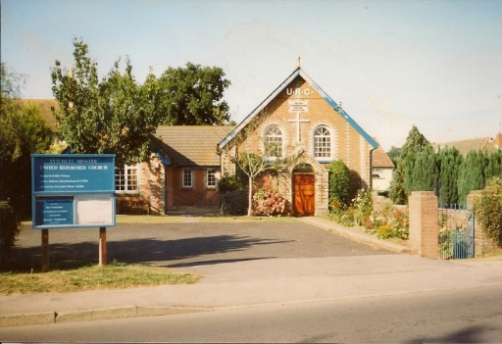
^{Synod 9: Wessex}
Lytchett Minster United Reformed Church ^{Lytchett Minster} ^{30 June 2016}

Slide 30
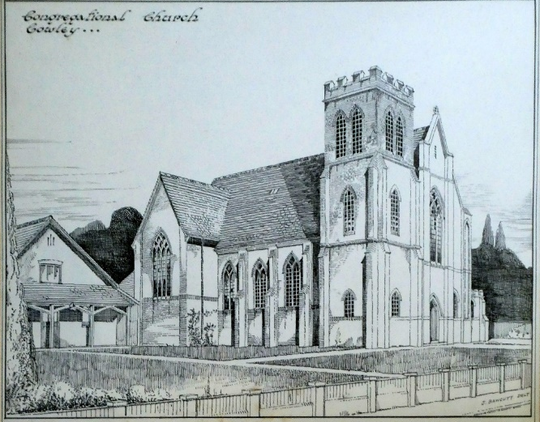
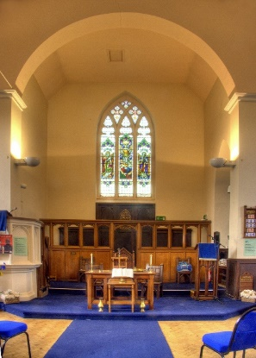
^{Synod 9: Wessex}
Temple Cowley United Reformed Church ^{Oxford} ^{5 November 2017}

Slide 31
^{Synod 10: Thames North}
Chigwell Row United Reformed Church ^{Chigwell} ^{30 September 2016}

Slide 32
^{Synod 10: Thames North}
^{Feltham United Free Church} ^{Feltham} ^{28 January 2018}

Slide 33
^{Synod 10: Thames North}
Queens Park United Reformed Church ^{London} ^{20 March 2016}

Slide 34
^{Synod: 11 Southern}
Folkestone United Reformed Church ^{Folkstone} ^{10 December 2016}

Slide 35
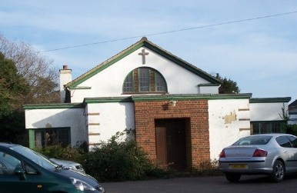
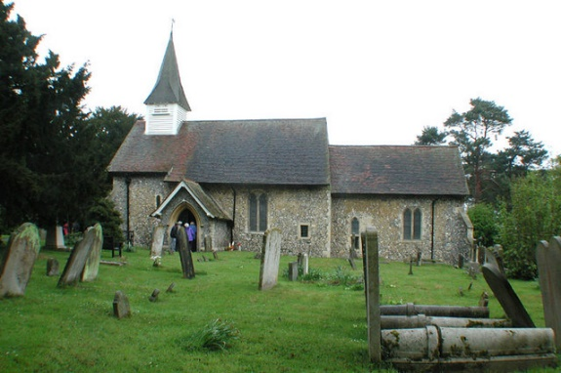
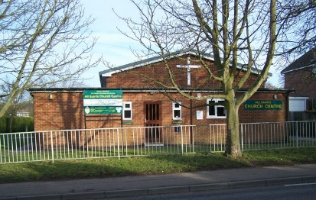
^{Synod 11 Southern}
^{Hartley United Reformed Church} ^{Hartley} ^{25 September 2016}

Slide 36
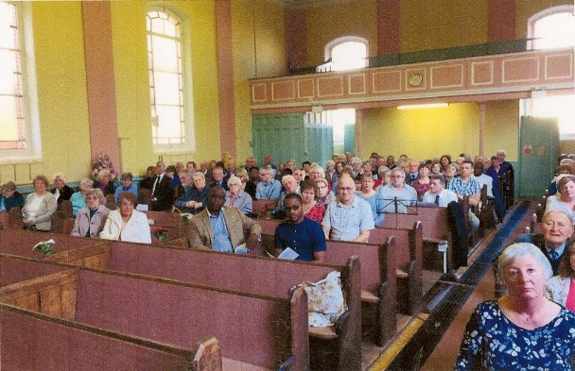
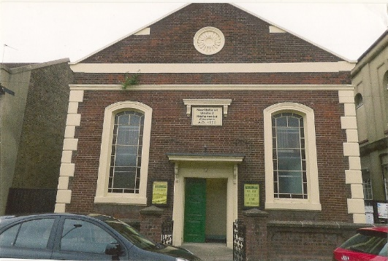
^{Synod 11 Southern}
Northfleet United Reformed Church ^{Northfleet} ^{2nd April 2017}

Slide 37
^{Synod 12: Wales}
^{Caersalem United Church} ^{Ebbw Vale} ^{18 April 2017} Noting that the URC withdrew from the local ecumenical partnership on 18 April 2017 but that it continues as a ^{Baptist church}

Slide 38
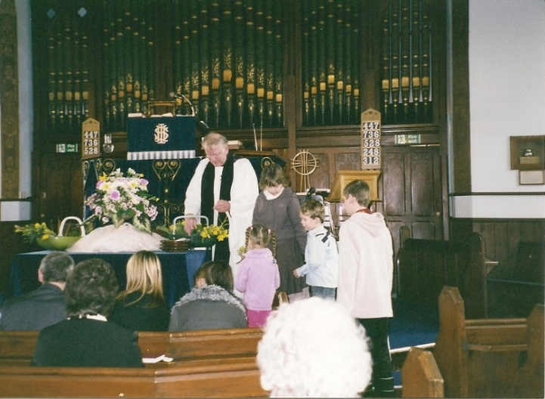
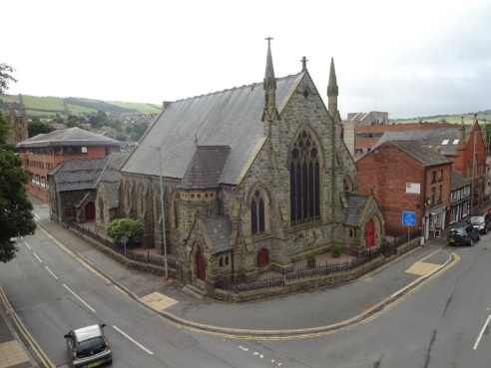
^{Synod 12: Wales}
^{Newtown United Reformed Church} ^{Newtown} ^{24 July 2016}

Slide 39
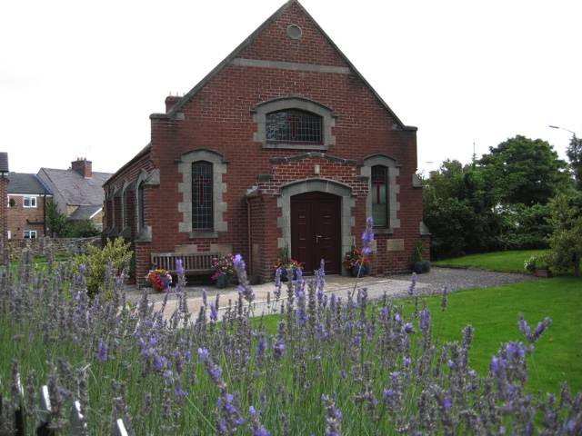
^{Synod 12: Wales} ^{Northop United Reformed Church} ^{Northop} ^{5 November 2017}

Slide 40
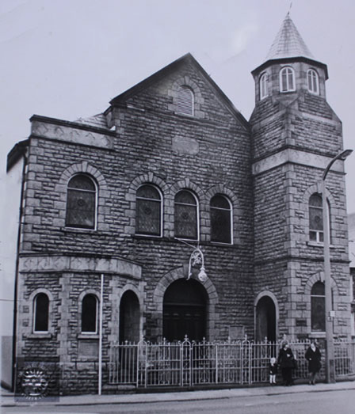
^{Synod 12: Wales}
^{Porth United Reformed Church} ^{Porth} ^{15 May 2016}

Slide 41
^{Synod 12: Wales}
^{Wesley United Reformed Church} ^{Abercynon} ^{14 January 2017}

Slide 42
^{Synod 13: Synod of Scotland}
Portobello United Reformed Church ^{Edinburgh} ^{30 April 2016}

Slide 43
^{Synod 13: Synod of Scotland}
^{Selkirk United Reformed Church} ^{Selkirk} ^{17 December 2017}

