Slide 1
Hints are everywhere we look as we investigate this book
We must search to see if we can find the truths.
With a magnifying glass, and the right amount of sass
We will be a group of modern supersleuths

Slide 2
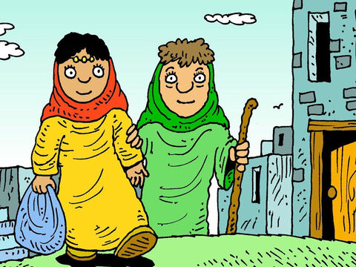
Where you go, that’s where I’ll go, so said Ruth
And where you live, that’s where I’ll live, that’s the truth
I will take your God as my God, and your people as my kin
For you love me and I love you, Our adventure must begin

Slide 3
Hints are everywhere we look as we investigate this book
We must search to see if we can find the truths.
With a magnifying glass, and the right amount of sass
We will be a group of modern supersleuths

Slide 4
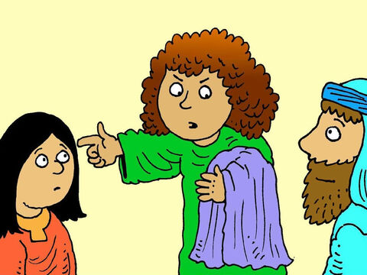
There was Mary, there was Martha in their home.
One was working, one was praying all alone.
Both things needed to be done, but it doesn’t sound much fun
But they knew that very soon they would be welcoming God’s son

Slide 5
Hints are everywhere we look as we investigate this book
We must search to see if we can find the truths.
With a magnifying glass, and the right amount of sass
We will be a group of modern supersleuths

Slide 6
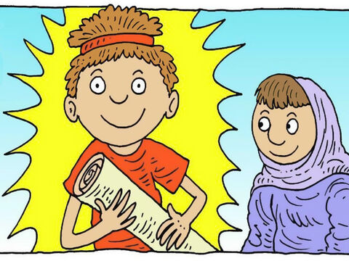
Timothy was really very young
At the time when his adventure just begun.
And when he answered God’s call, it was helping his friend Paul,
He showed courage and encouraged him to share God’s love with all.

Slide 7
Hints are everywhere we look as we investigate this book
We must search to see if we can find the truths.
With a magnifying glass, and the right amount of sass
We will be a group of modern supersleuths

Slide 8
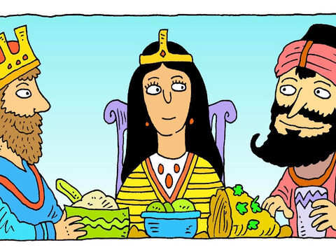
Esther lives in Persia, she’s a Jew.
And though scared she knew just what she had to do.
She gave Xerxes a request: please don’t keep my kin oppressed
Is she a hero or a villain? What d’you think, what’s your guess?

Slide 9
Hints are everywhere we look as we investigate this book
We must search to see if we can find the truths.
With a magnifying glass, and the right amount of sass
We will be a group of modern supersleuths

Slide 10
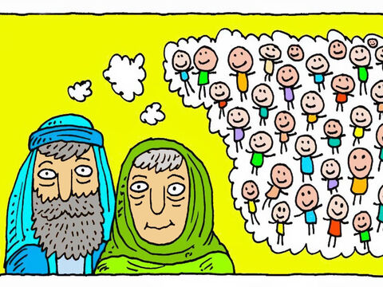
Abraham and Sarah were quite old.
They could not have any children, they’d been told.
Ishmael did no wrong, but then Isaac came along.
Who’s the hero, who’s the villain in this song?

Slide 11
Hints are everywhere we look as we investigate this book
We must search to see if we can find the truths.
With a magnifying glass, and the right amount of sass
We will be a group of modern supersleuths
Words and music by Leo Roberts
Bible images from lambsongs.co.nz

